Slide 1
Forward Error Correction Strategies

Slide 2
FORWARD ERROR CORRECTION
INTRODUCTION
PROBLEM DESCRIPTION
MAIN RESULTS

Slide 3
WHAT IS FORWARD ERROR CORRECTION?
FEC stands for Forward Error Correction. FEC is a system of error control for data transmission, wherein the sender adds redundant data to its messages.
Redundancy refers to the additional bits or symbols that are included in the transmitted message to ensure error detection and correction at the receiving end

Slide 4


Slide 5
FEC CODING TECHNIQUES
REED SOLOMON CODES
Low Density Parity Check Codes

Slide 6
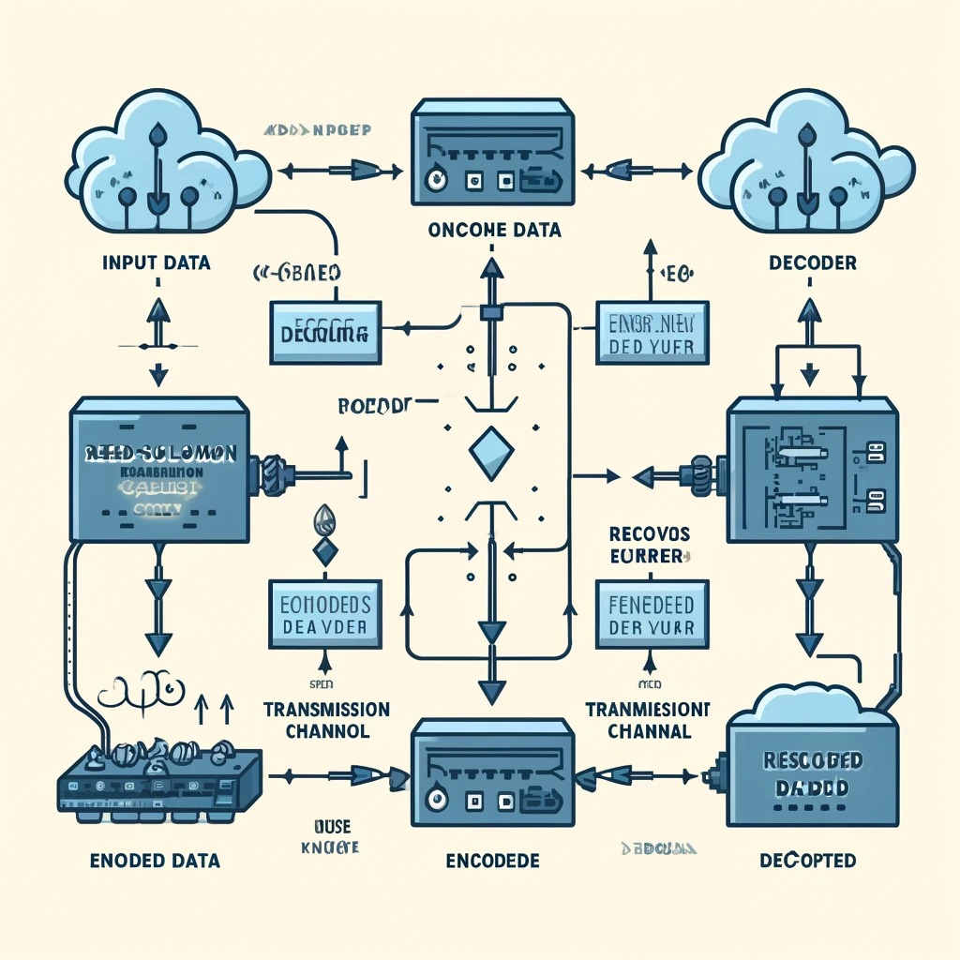
REED SOLOMON CODES
Reed-Solomon codes are a type of error-correcting codes that are particularly effective in correcting burst errors, which are clusters of errors that occur in a row in the data sequence.

Slide 7


Slide 8

Low Density Parity Check Codes
Low-Density Parity-Check (LDPC) codes are a type of error-correcting code used to transmit messages over noisy transmission channels. They are known for their capacity to approach the Shannon limit, which is the theoretical maximum rate of data transmission for a specific noise level.

Slide 9

HOW DOES LDPC CODES WORK ?

Slide 10
FEC CODE OPTIMIZATIONS
UNEQUAL FEC PROTECTION
providing higher protection to the more important parts (e.g., Intracoded VOP) of a low-priority VO is better than protecting the less important parts (e.g., B-VOP) of a high-priority VO
INTERLEAVED FEC PROTECTION
Data interleaving in video streaming is employed to reduce the effects of packet loss. It involves re-sequencing packets before transmission so that packets originally adjacent are spread out

Slide 11
PACKET LOSS PROCESS CHARACTERIZATION
The Gilbert and Extended Gilbert models are statistical models used for understanding packet loss behavior in network communications, especially for multimedia streaming and similar applications where packet loss can significantly impact quality. The Gilbert Model, or two-state Markov model, is designed to capture the dependency of packet losses over time, making it more realistic than simple independent loss models like the Bernoulli model

Slide 13
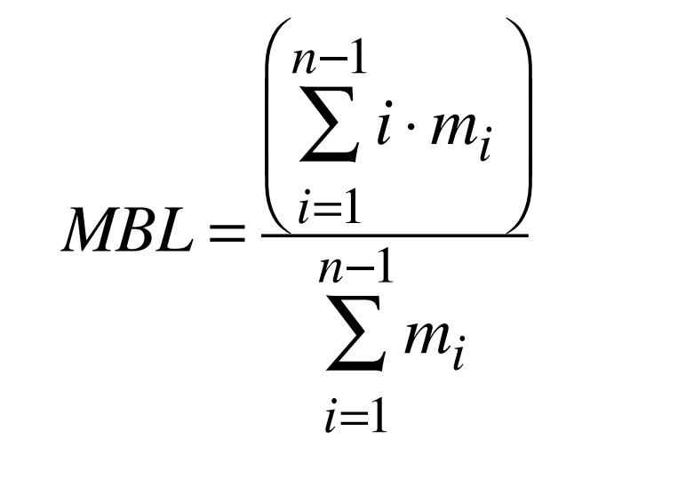
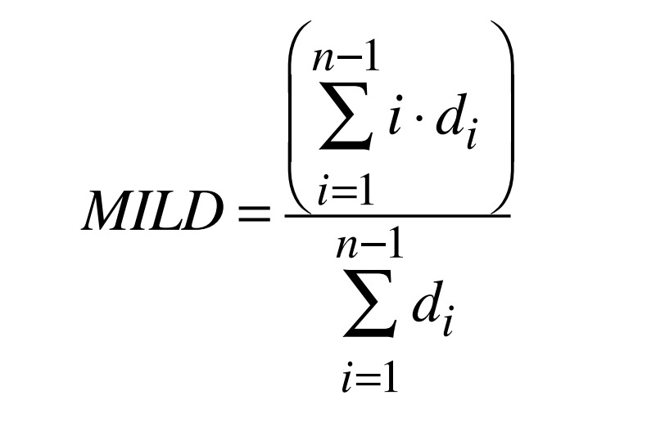
Mean burst loss length (MBL)
Mean interloss distance(MILD)

Slide 14
PACKET-LEVEL FEC PERFORMANCE METRICS
Redundancy ratio
Decoding inefficiency ratio (inef_ratio)
Encoding/decoding times and bandwidth

Slide 18
CONCLUSION
Importance of QoS Provisioning
Reliability through FEC
Adaptive FEC Protocol
Novel Metrics for Better Adaptation
Examples

